Slide 1
PREDICTIVE MODELING
Renewable Energy Generation Forecasting
AI-driven grid stabilization via localized meteorological integration.

Slide 2



Unified Forecasting Pipeline
Grid Energy
Regional Weather
Feature Matrix
Historical load metrics.
Localized meteorological features.
35K+ time-aligned records.

Slide 3
Robust Outlier Treatment
Extreme Skewness
Quantile Transformation
Erratic pressure and wind variance.
Uniform feature distributions.
Model instability.
Stabilized learning gradient.

Slide 4
Preventing Target Leakage
Day-ahead forecasts serve as artificial anchors, obscuring true meteorological signals.
Features
Solar Gen
Day Ahead Fcst
Temperature
Humidity
Solar Gen
1.00
0.99
0.46
-0.50
Day Ahead Fcst
0.99
1.00
0.46
-0.50
Temperature
0.46
0.46
1.00
-0.40
Humidity
-0.50
-0.50
-0.40
1.00

Slide 5
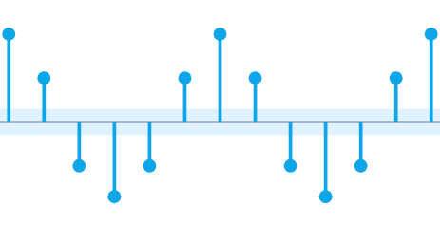
DATA SIGNATURES
Temporal Generation Patterns
9-Hour Peak Production Window
24h Autocorrelation Cycle (ACF)
Hour of Day (0-23)
Lag (Hours) 0-48

Slide 6
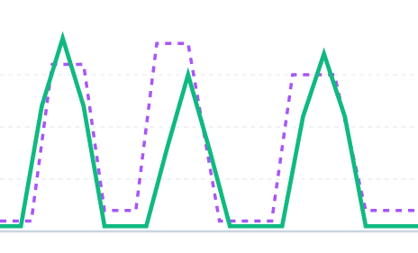
Solar Generation vs. Cloud Cover
THE CHALLENGE
The Intermittency Problem
Solar generation is highly volatile. Rapid weather shifts cause sudden production gaps that static baselines fail to predict.
Actual Generation
Regional Cloud Cover

Slide 7
Algorithm Evaluation
Linear Regression
Random Forest
XGBoost
Baseline benchmark.
Ensemble architecture.
Regularized gradient boosting.
Optimized predictive balance.
Highly overfitted.
High variance output.

Slide 8
Final XGBoost Validation
R² SCORE DROP-OFF
MEAN ABSOLUTE ERROR (MW)
Training
0.84
Training
465
Validation
0.57
Validation
839

Slide 9






Strategic Grid Impact
Grid Stability
Sustainability
Scalable Architecture
Neutralizes fossil-fuel peaker plant reliance.
Advances UN climate action goals.
Adaptable across diverse geographic networks.

Slide 10
Questions & Review
Thank you for your time.

